Slide 1
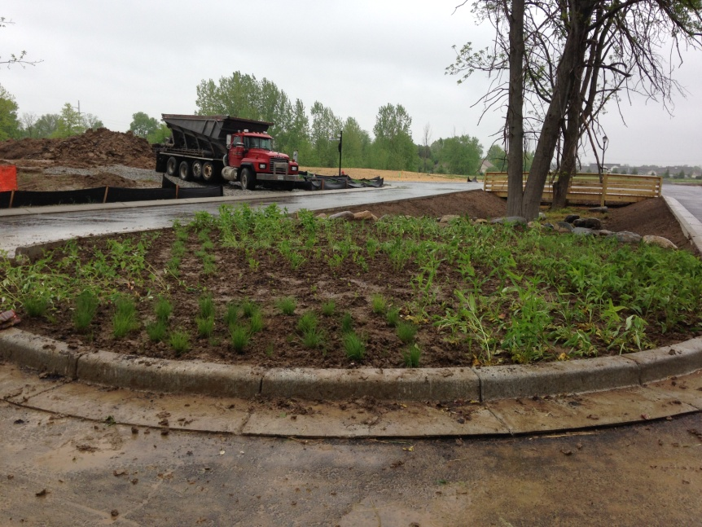
“Landscaping for Water Quality” Demonstration Projects
Cindy Martin
Claire Lane
Michael Morgan
Wes Rood

Slide 2
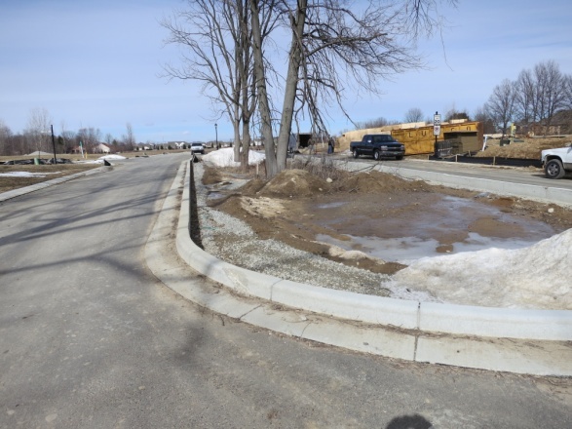
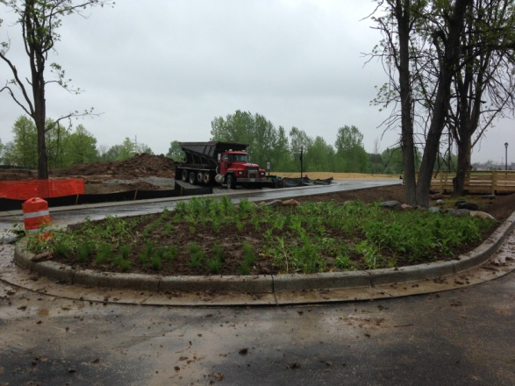
Why create a demo project?
Education
Public awareness
Examples
Inspiration
Research
Set a good example

Slide 3
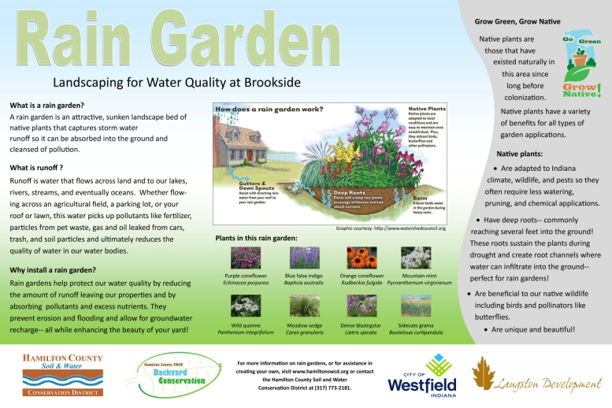
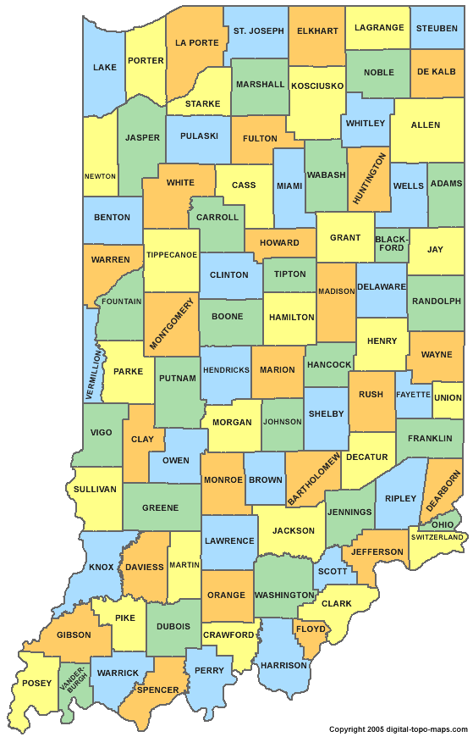
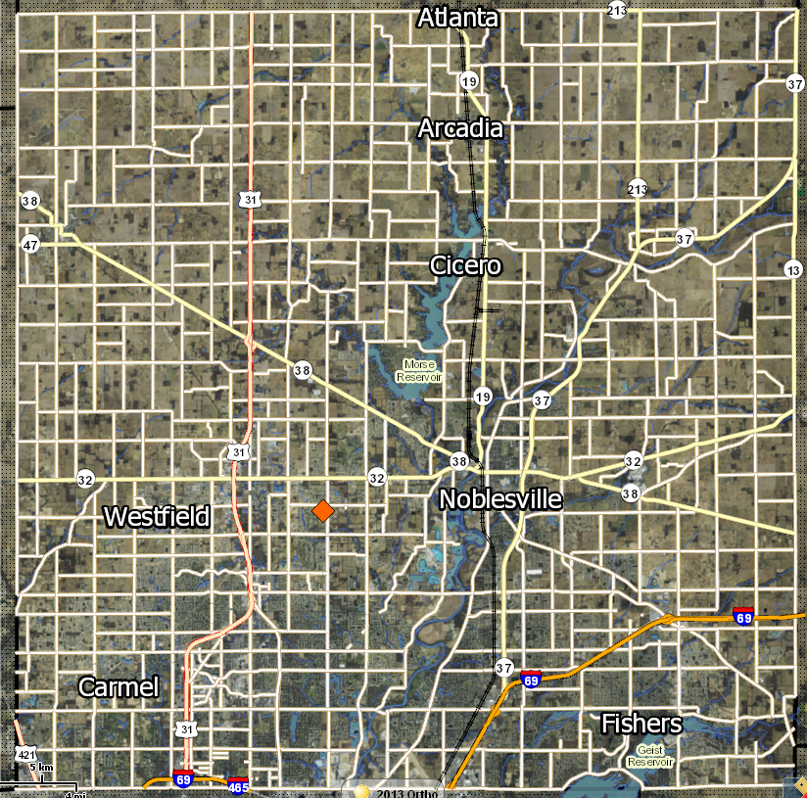
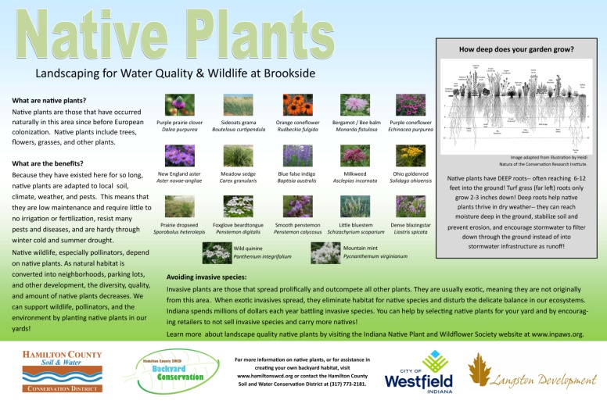
Developing demonstration projects
Home-A-Rama
Considerations:
Location
Make connections
Message
What’s the focus
Signage
Design
Special considerations
Challenges:
Site selection/partnerships
Payment
Design
Maintenance

Slide 4
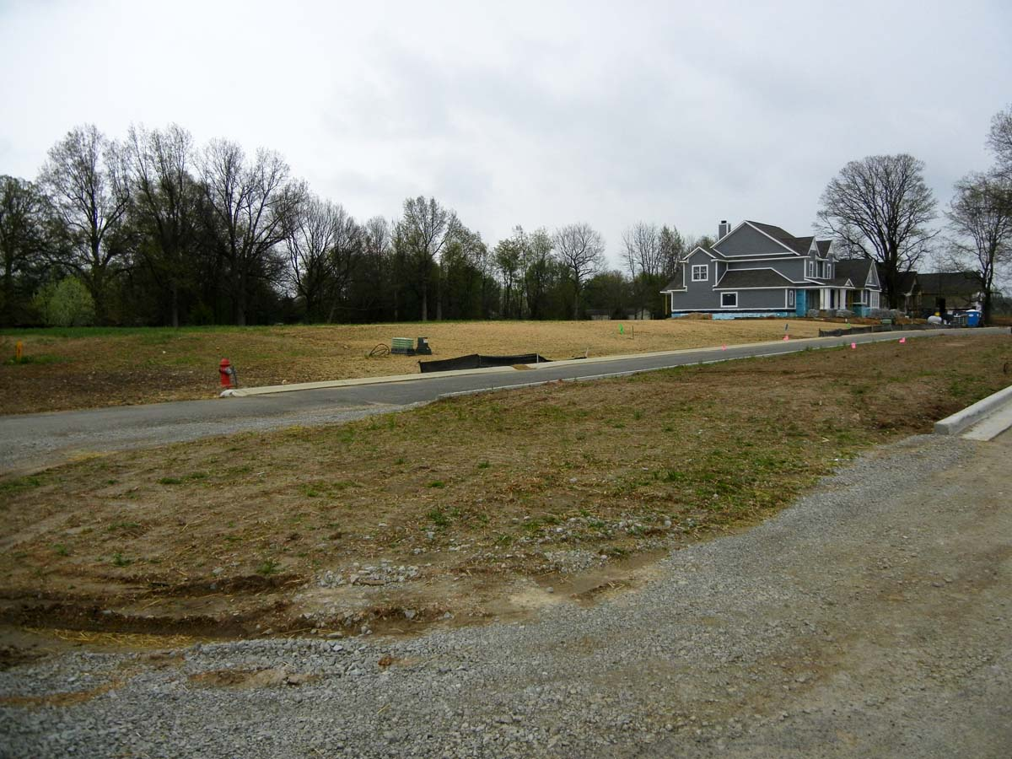
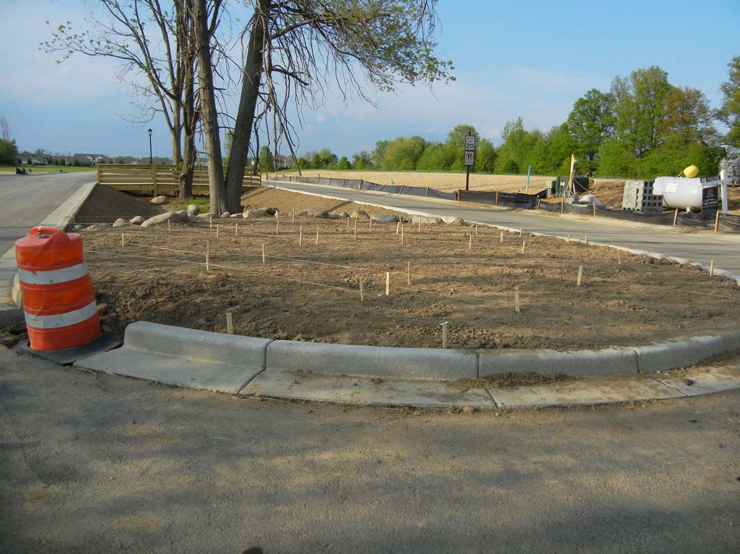
Garden design considerations
Soil – medium, clay
Light – +6 hours/day
Moisture – mesic to dry
Height – under 4’
Well-behaved plants
Variety – grasses, wildflowers, color, texture, seasonal interest, showy

Slide 5
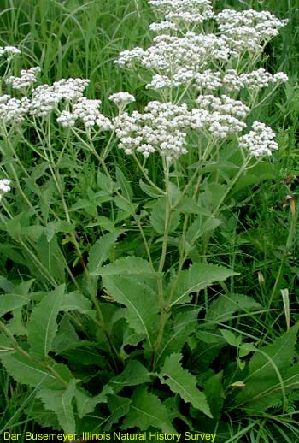
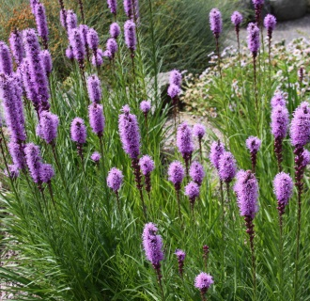
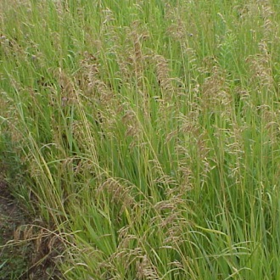
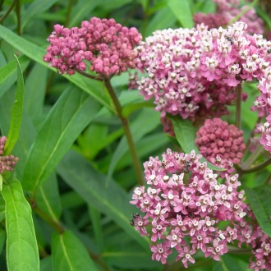
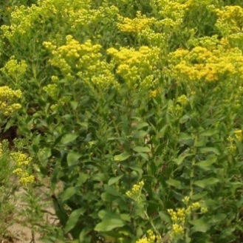
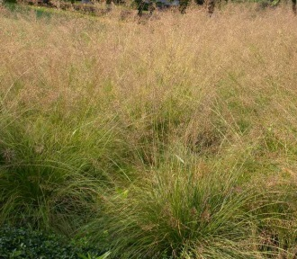
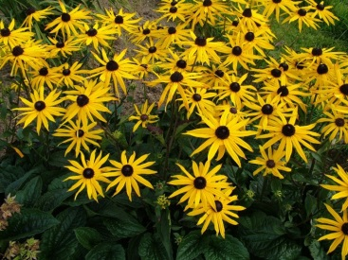
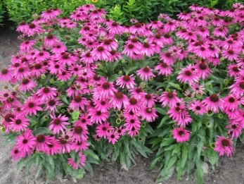
Brookside Native Plants

Slide 6
Brookside Rain Garden

Slide 7
Brookside Native Garden

Slide 8
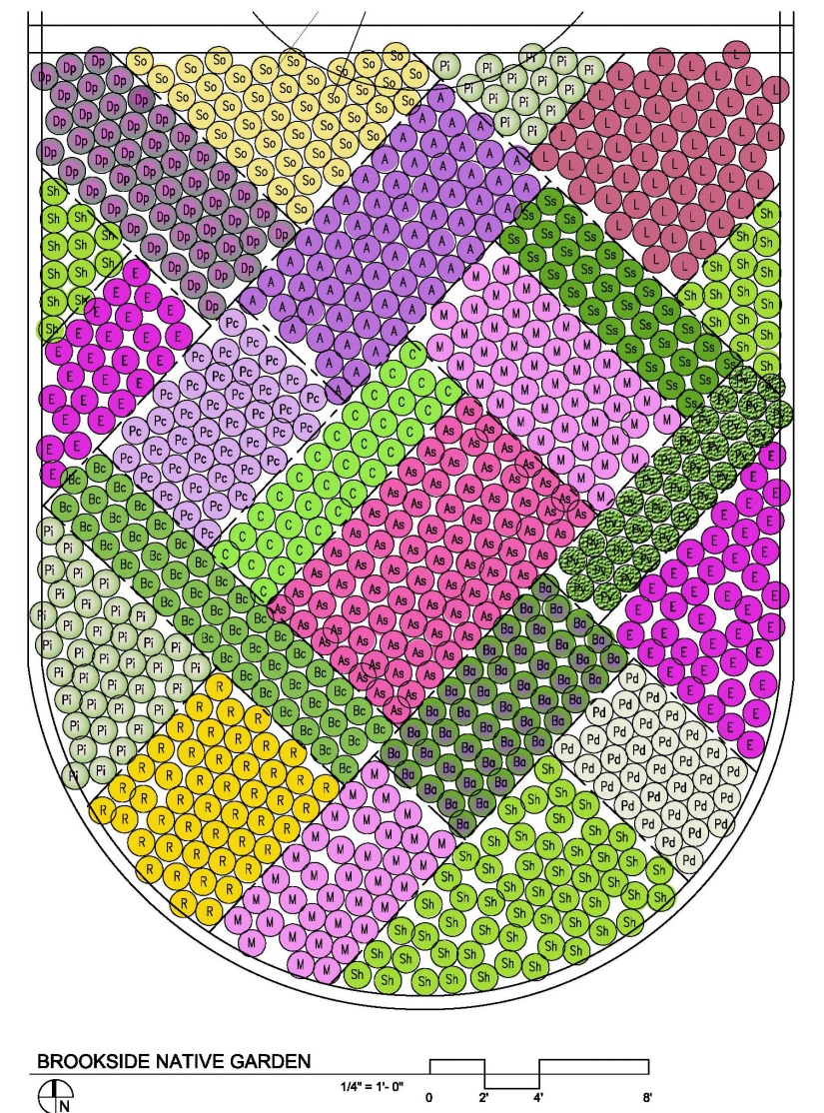
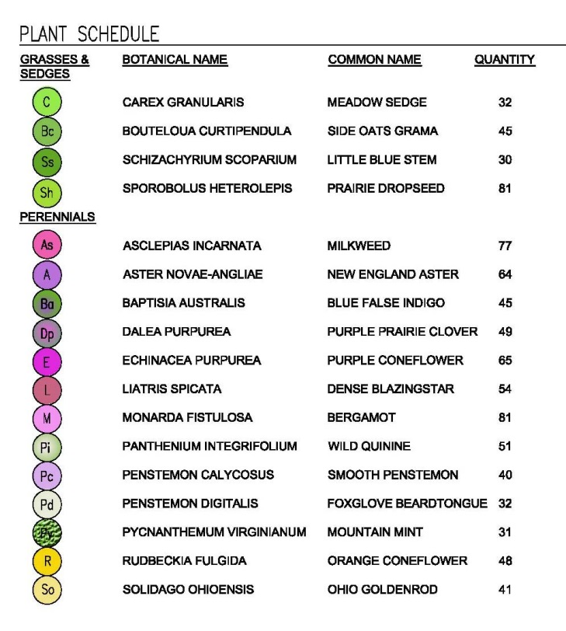
Brookside Native Garden
Notes:
Here is the final planting plan for the native garden. There are 4 different grass species and 13 wildflower species.

Slide 9
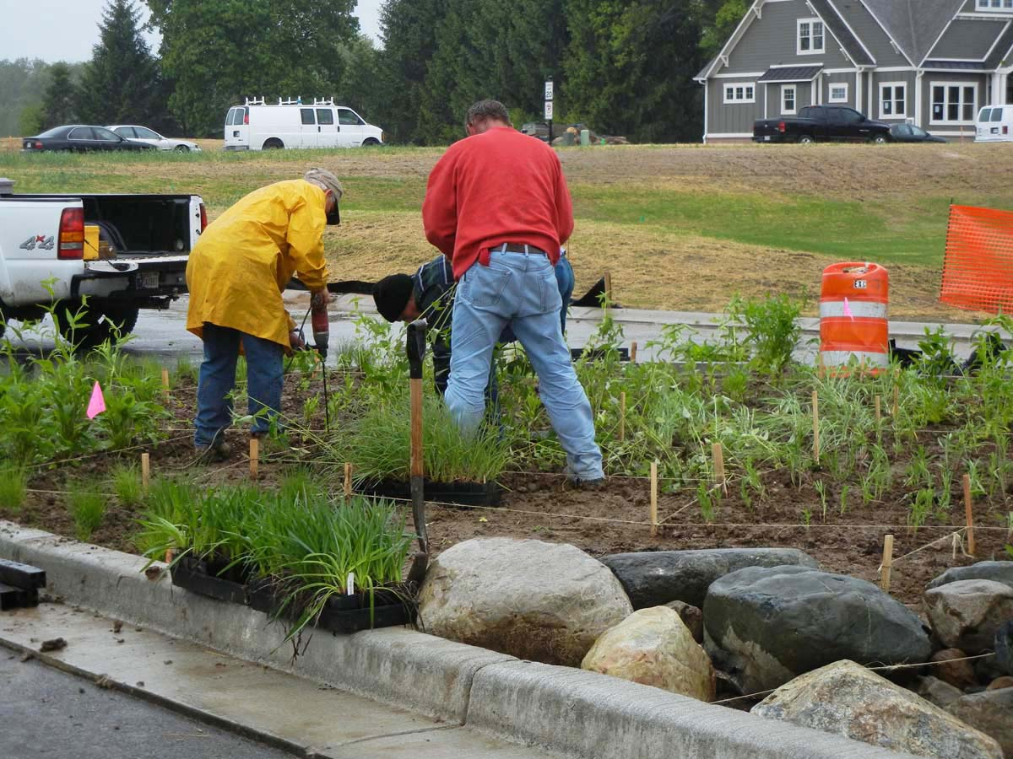
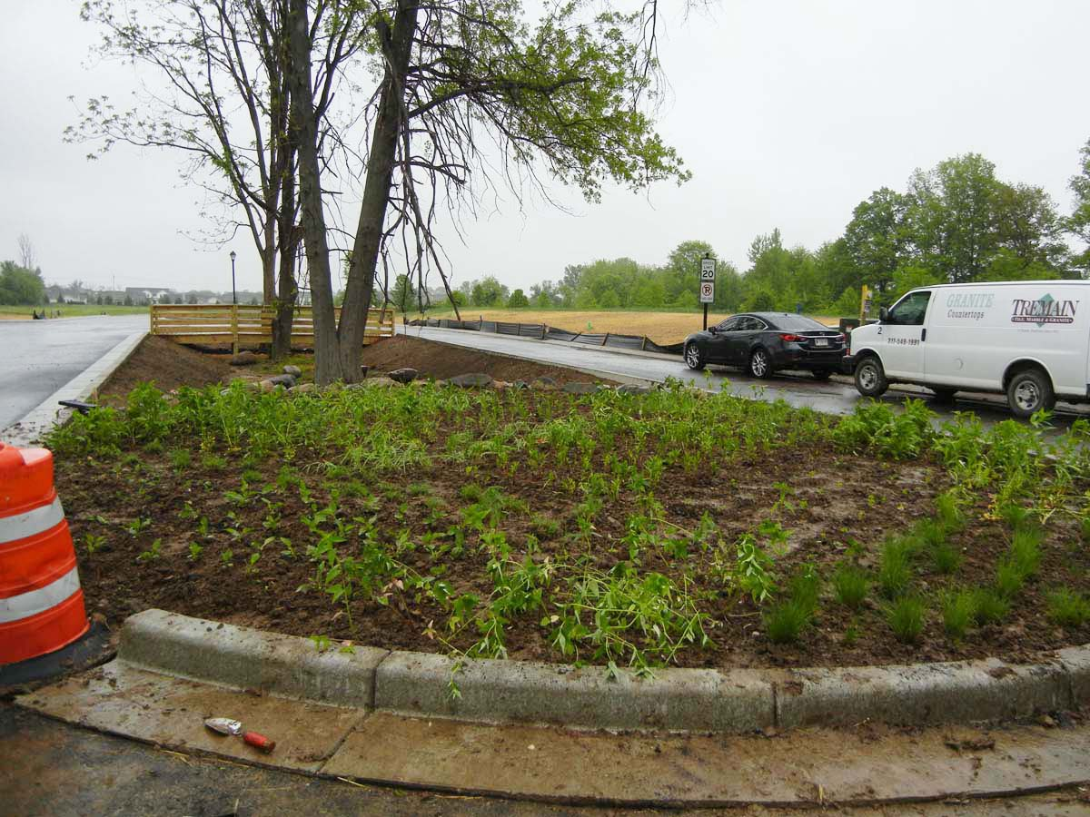
Brookside Gardens

Slide 10
MS4 Perspective
Meeting MS4 MCM Requirements
MCM 1- Public Education and Outreach
MCM 2- Public Involvement and Participation
Notes:
Public Education and Outreach= Meeting with homeowners to discuss how to develop and create Rain Garden’s, Rain Barrels, and Native Plants. Discuss how the City has put canned presentations on Facebook and Twitter as well as partnering with the Upper White River Watershed Alliance to get messages out to the public. Because the Home-a-Rama will have lots of visitors, signs were placed for the demonstration sight.
Public Involvement= Working with the Hamilton County SWCD in an effort to create a demonstration site is one component to get participation and involvement from other like minded entities. Getting Developers and Contractors to help with the grading and site preparation was a component of involvement provided for our demonstration sight.
Follow in with Slides about the signs that are being installed.

Slide 11
Rain Garden Sign

Slide 12
Native Plants Sign

Slide 13
Encouraging Water Wise BMPs
The City of Westfield has adopted Best Management Practices
Chpt. 700 LID “Low Impact Development”
Minimum standards for selection and design of BMPs
Notes:
As The City of Westfield grows and there is an ever important issue of stormwater quality and management, options of Low Impact Development helps with the detention of stormwater but also improves the quality of water entering our watershed.

Slide 14
Developing Partnerships
Positive Communication
Expressing Importance
Schedule Face to Face Meetings
Seeing Results and Rewards

